Slide 1

JA COMPANY PROGRAM
PHASE 2: UNITE
WEEK 4

Slide 2

WEEK 4 AGENDA
PHASE 2: UNITE
ATTENDANCE & ICE BREAKER (25 MIN)
SELECTION PROCESS (30 MIN)
EXECUTIVE TEAM & ALL ROLES (60 MIN)
EMPLOYEE HANDBOOK (15 MIN)
ENTREPRENUERIAL RESILIENCY MODULES (10 MIN)
QUESTIONS & WRAP UP (5 MIN)

Slide 3


WELCOME TO WEEK 4

Slide 4

Ice Breaker
LEADERSHIP
ICE BREAKER
Notes:
Ice breaker (15 min)
Choose 1 of the Leadership Ice Breakers from the Team Builders and Ice Breakers document
This will allow students to do something fun prior to the selection process and also provide a final opportunity to review important leadership qualities.
Virtual facilitation note: Use the collaboration tool (i.e. Mural) assigned by your charter if you are delivering virtually.

Slide 5
EXECUTIVE TEAM & ALL ROLES

Slide 6
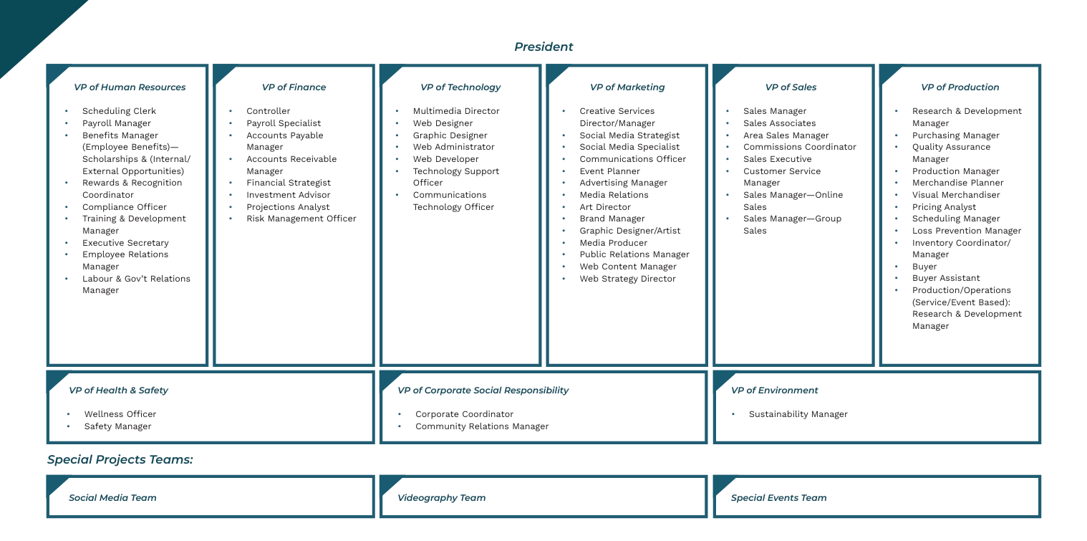
Executive Team & All Roles
Notes:
Executive Team & All Roles (30 min)
Agenda note: You can move this to Week 5 if you have not yet completed your idea pitches.
Once the executive team is determined, you will work with department heads and remaining non-executives to determine where remaining stakeholders would fit best into the organization based on their self-assessment and their interest in the functional areas and roles
Non-executives migrate to the department in which they are interested.
Stakeholders then discuss possible positions with the department head and other interested stakeholders. Refer to the Org Chart with all Department Roles PDF.
Examples are given of possible positions, but stakeholders are able to take the initiative and develop their own personalized position – ultimately, each stakeholder in the company should have a role, function, and accountability (this also applies to advisors)
If a social media account is to be used for communications purposes outside of the weekly meetings (group chats, etc), emphasize the need for keeping all Company information/data and conversations private to only Company members, is to be reinforced.

Slide 7
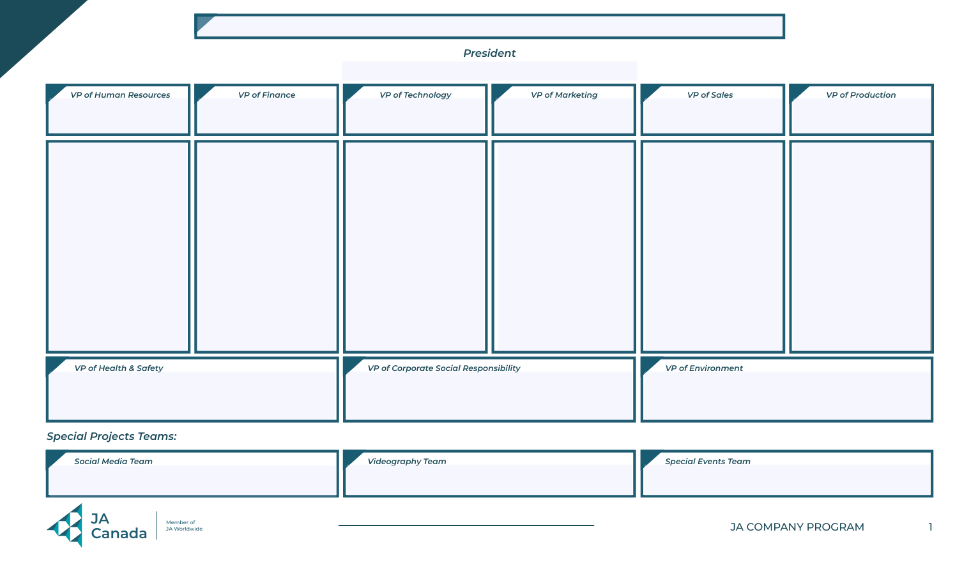
Organizational Structure
Complete the Organizational Structure template.
Map out all roles and names.
Notes:
Executive Team & All Roles (30 min)
Refer to the Organization Structure Template PDF.
This should be finalized and mapped out before the end of this meeting.

Slide 8
EMPLOYEE HANDBOOK

Slide 9

Employee Handbook
An employee handbook is a document that includes information that employees may need to refer to frequently to meet the terms and conditions of their employment.
Having established policies will help eliminate confusion about what is expected from everyone.
Notes:
Employee Handbook(15 mins)
Agenda note: You can move this to Week 5 if you have not completed your idea pitches.
Define what an employee handbook is and discuss its purpose.

Slide 10

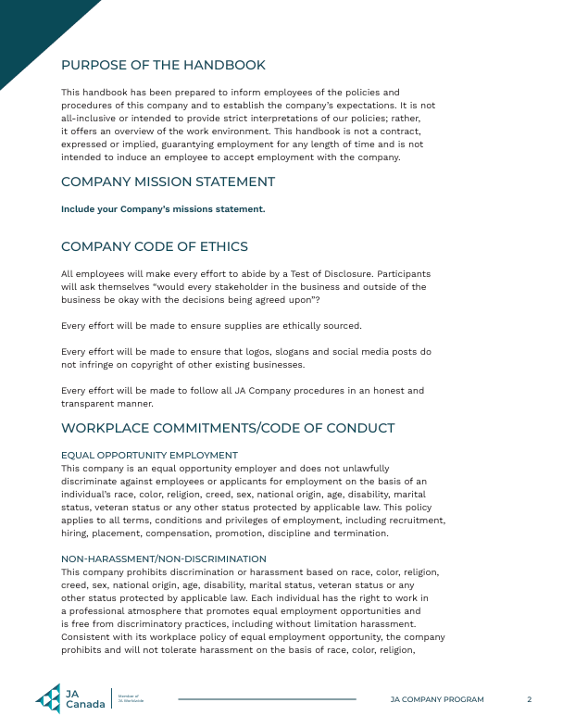

Employee Handbook Template
The VP of HR will oversee the creation of the Employee Handbook.
Notes:
Employee Handbook(15 mins)
Take the time to introduce briefly the Employee Handbook Template (and advise students to consider how they will modify the handbook to meet their company requirements).
See the next slide to review as a group the Code of Ethics and Test of Disclosure elements contained in the handbook to emphasize their importance.
The VP of HR will oversee the creation of the Employee Handbook, which will be due in Week 6. The VP of HR will collect the signed Code of Ethics agreement to keep as a record.

Slide 11
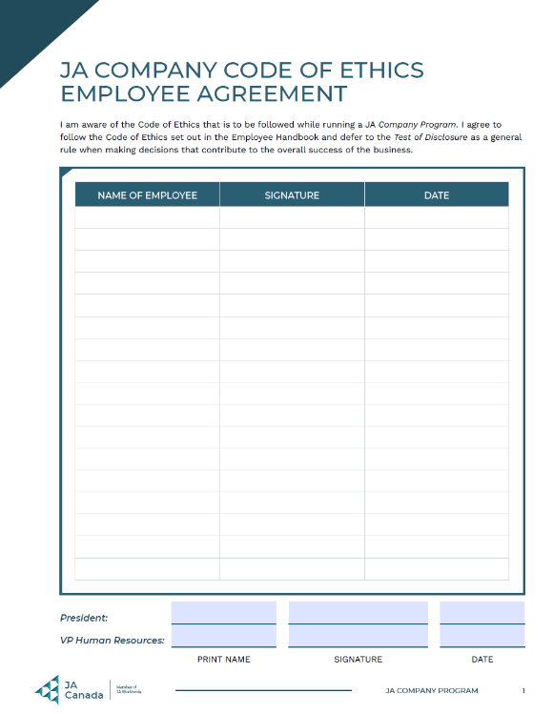
Company Code of Ethics
All employees will make every effort to abide by the Test of Disclosure.
Participants will ask themselves, “Would every stakeholder in the business and outside of the business be okay with the decisions being agreed upon”?
Every effort will be made to ensure supplies are ethically sourced.
Every effort will be made to ensure that logos, slogans and social media posts do not infringe on the copyright of other existing businesses.
Every effort will be made to follow all JA Company procedures in an honest and transparent manner.
The VP of HR will collect the signed Code of Ethics agreement.
Notes:
Employee Handbook(15 mins)
Review as a group the Code of Ethics and Test of Disclosure elements contained in the handbook to emphasize their importance.
The VP of HR will oversee the creation of the Employee Handbook, which will be due in Week 6. The VP of HR will collect the signed Code of Ethics agreement to keep as a record.

Slide 12
ENTREPRENEURIAL RESILIENCY MODULES

Slide 13
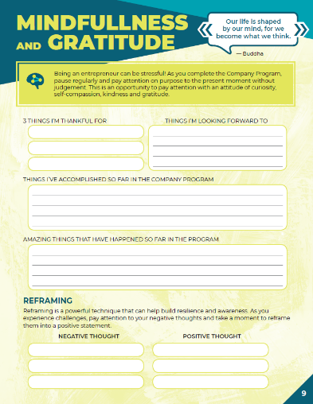
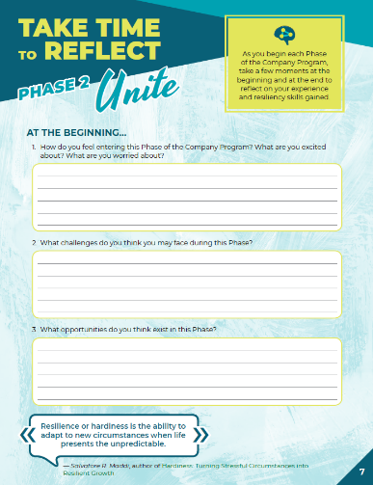

Company Program Resiliency Modules
Entrepreneurial resiliency is the ability to adapt to changes in your business and bounce back when things are challenging.
As you complete the JA Company Program, use this journal to reflect on your own resiliency and the skills you are gaining.
Notes:
Company Program Resiliency Modules (10 min)
Using the Company Program Resiliency Modules advisor guide, follow the instructions to guide students through the activities and discussions for Phase 2.

Slide 14
QUESTIONS & WRAP UP

Slide 15



Questions & Next Steps
QUESTIONS?
NEXT STEPS
Review the Department Responsibilities document and other department resources on JA Campus
Notes:
Wrap-Up (5 min)
Congratulate students on successful elections and forming their teams. This is a great accomplishment.
Create an opening for students to ask any questions about the meeting prior to wrapping up.
Review the next steps with students:
Encourage students, especially the Management Team, to visit JA Campus and review the Department Responsibilities document as well as the resources available by department in preparation for Phase 3: Build.
Advisors:
Gather attendance records and any outstanding forms to share with the local JA Charter office.
If you were not able to cover any material, make a note and move it to your next meeting.
Address any questions, concerns or feedback to your Company Program Manager.
Review Department Responsibilities and the Record Keeping Tool in preparation for the next phase.
Executive Team Training (Outside of Regular Hours):
Learning opportunity for the student executives to attend and led by the local JA Charter. Check with your Company Program manager for more information.

